Slide 1

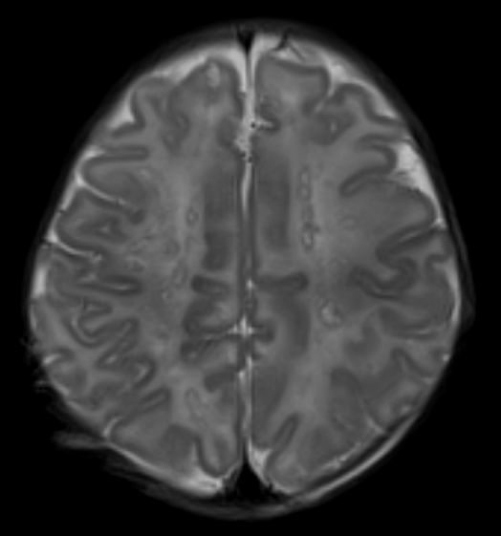
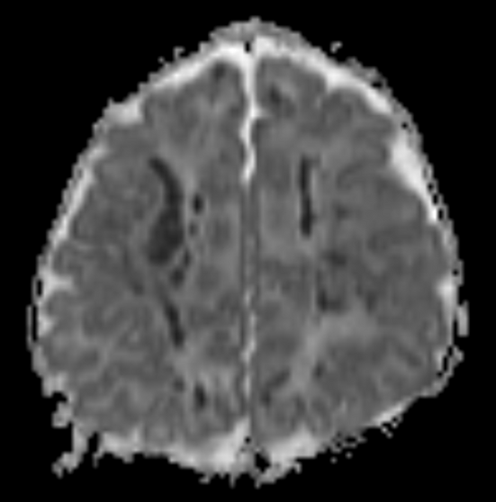
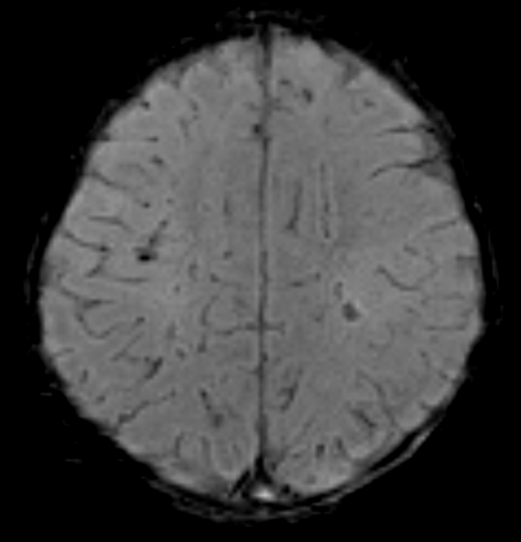
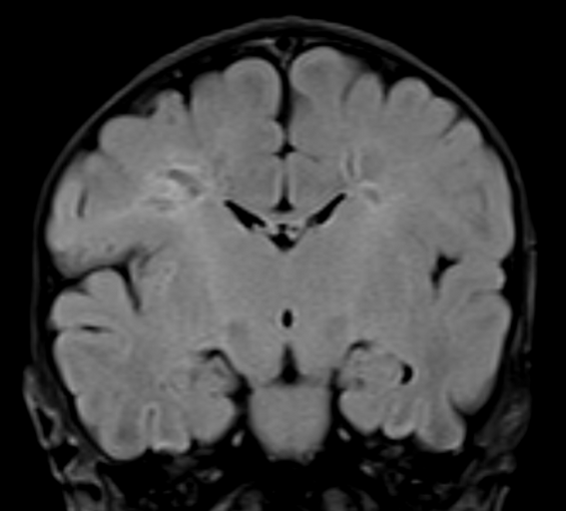
History & Imaging
Breif patient summary
Image description

Slide 2
Differential Diagnosis
Periventricular leukomalacia?
Deep arterial borderzone infarcts?
Deep medullary venous infarction?
Infection (e.g. Parechovirus)?
Inborn errors of metabolism
Mitochondrial?
Genetic small vessel disease?
Interferonopathy?
Other?

Slide 3
Diagnosis
Incontinentia pigmenti (X-linked dominant, IKBKG ).
Enokizono et al. Jpn J of Radiol 2024
Salamon et al. Dev Med Child Neurol 2016

Slide 4
Discussion
Incontinentia pigmenti (X-linked dominant, IKBKG )
Rare genodermatosis with variable phenotype in females, generally fatal in males, caused by IBKG mutation, a gene involved in preventing TNF-α induced apoptosis and regulating immune- and inflammatory responses.
Clinically presents with skin, central nervous system (30%), eye, teeth, hair, and nail involvement. Neurologic disease often presents in the neonatal period with encephalopathy and seizures.
Skin involvement progresses through four stages: vesicular, verrucous, hyperpigmented, and hypopigmented/atrophic stage. High risk of retinal detachment.
MRI can show periventricular and subcortical white matter disease, hemorrhagic changes, corpus callosum hypoplasia, polymicrogyria and other malformations of cortical development and atrophy. Multifocal speckled diffusion restricting white matter lesions are common in the acute phase.
Enokizono et al. Jpn J of Radiol 2024
Salamon et al. Dev Med Child Neurol 2016

